Slide 1

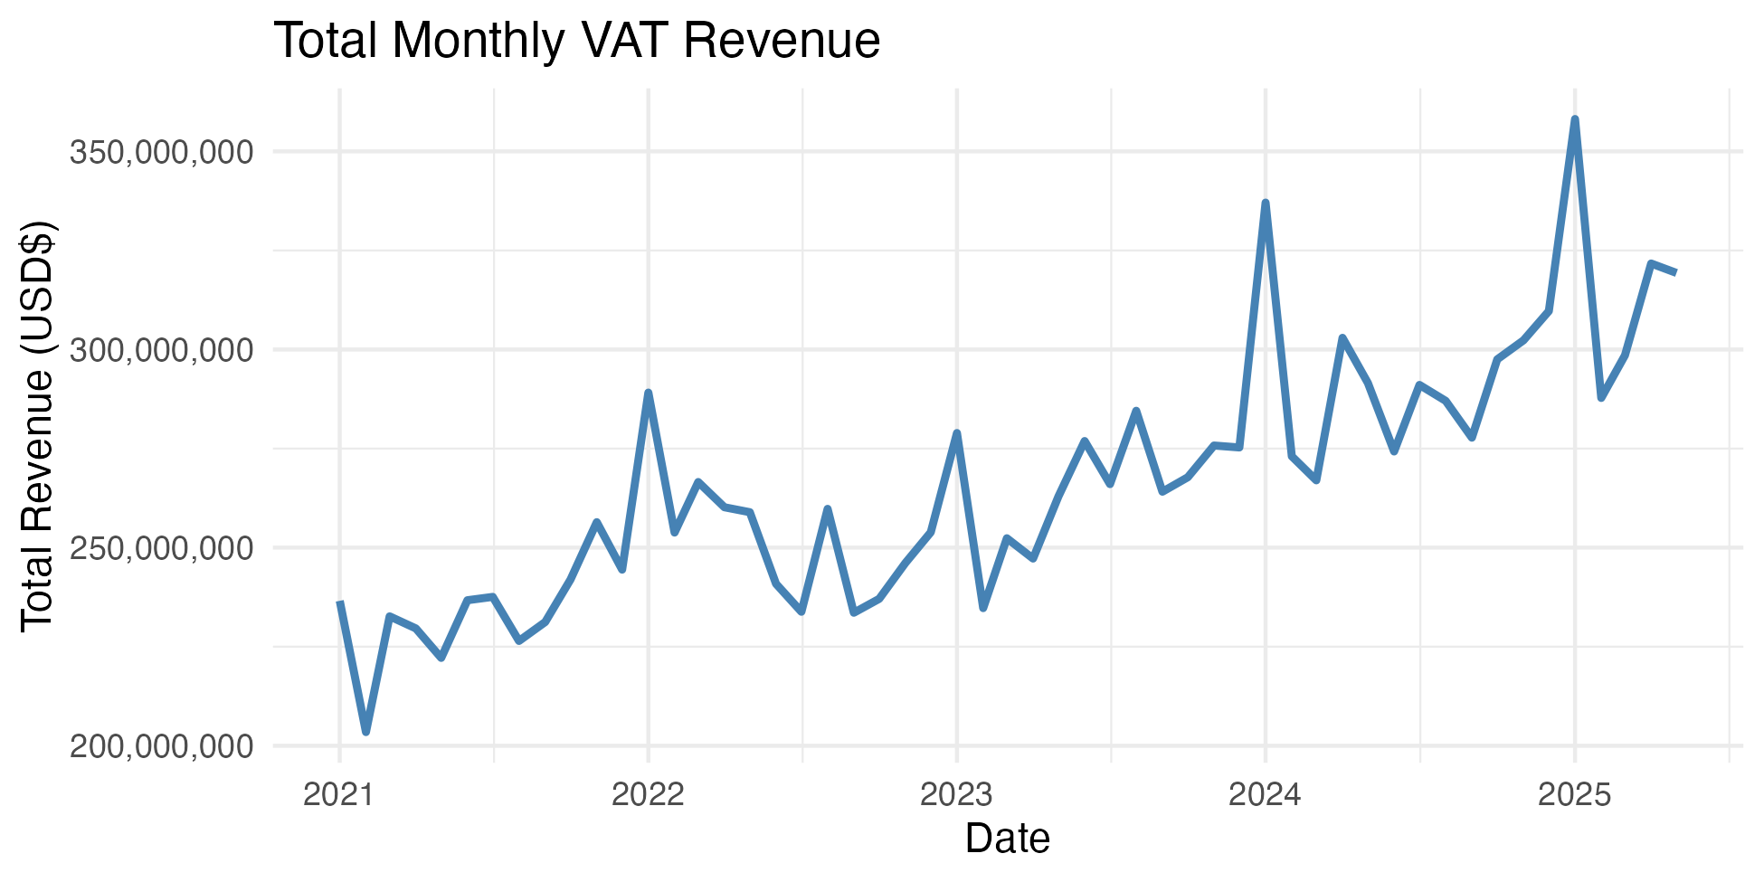
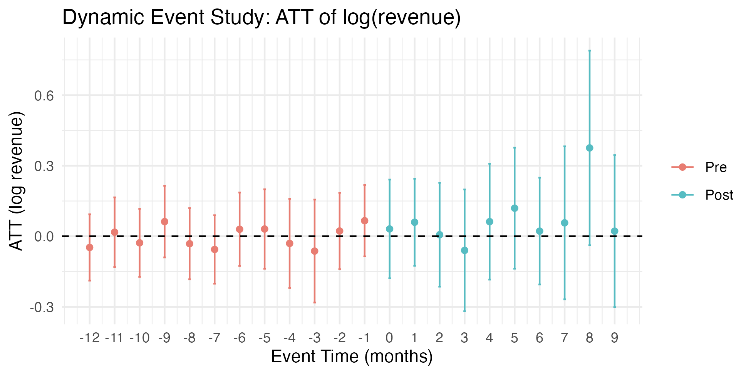
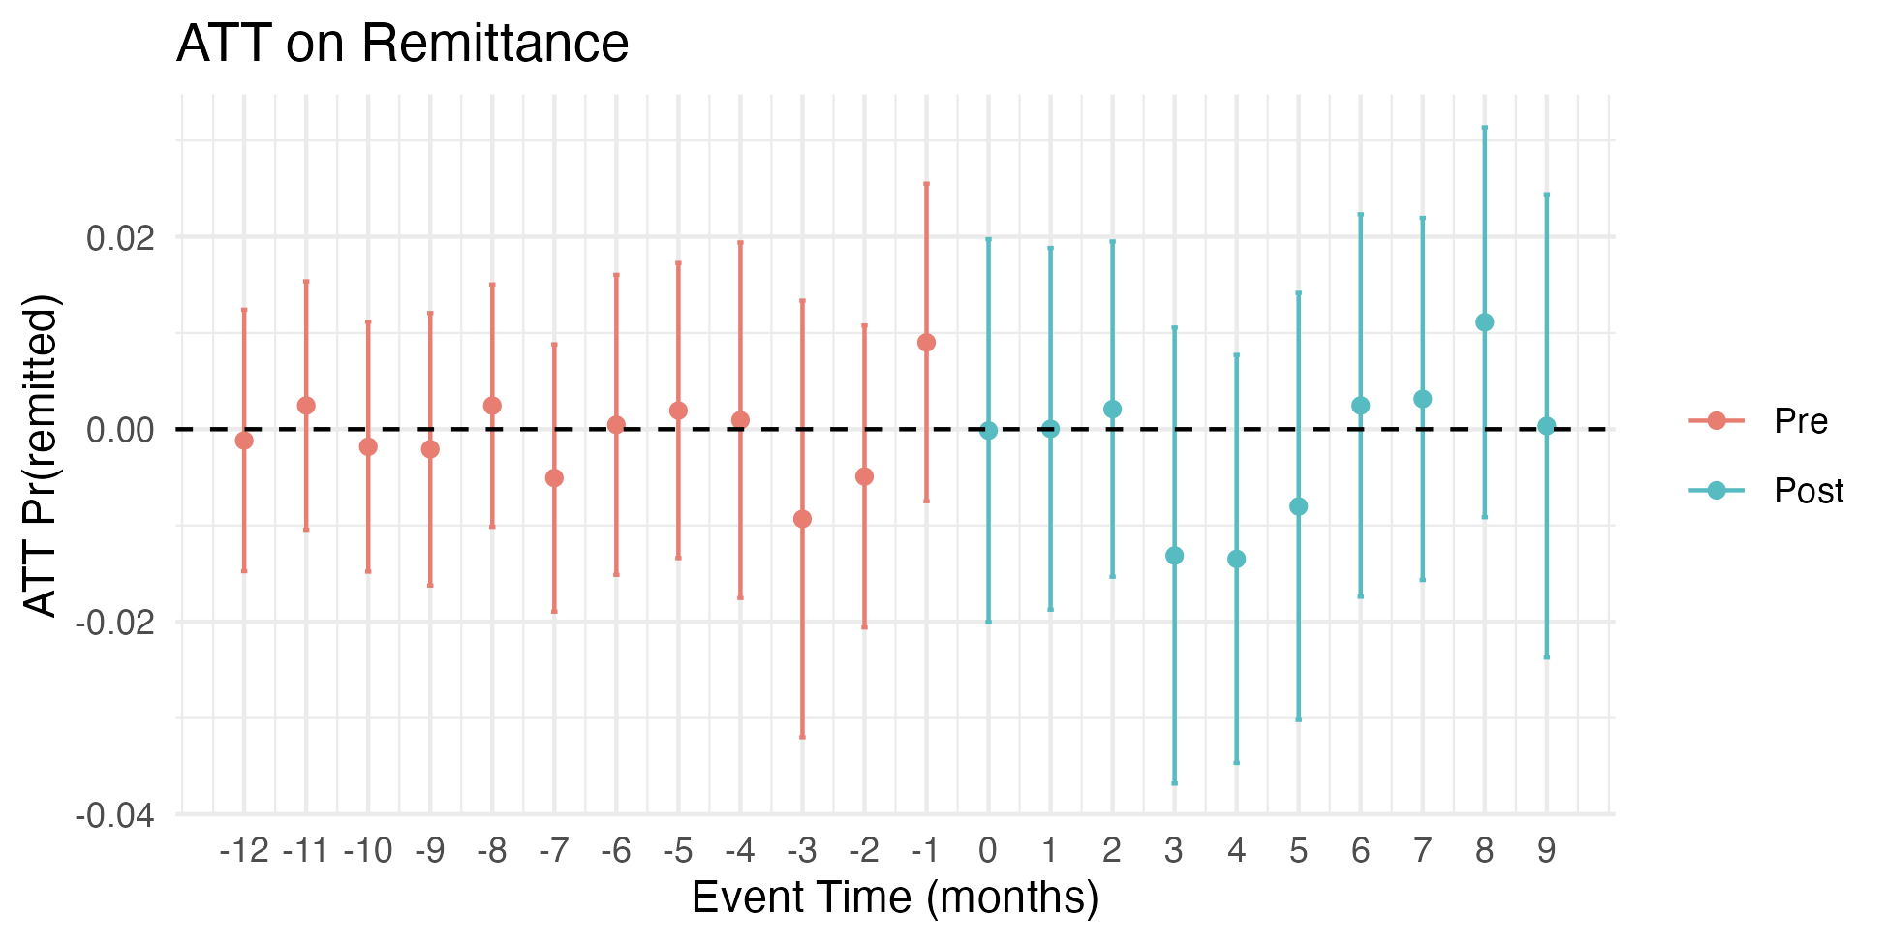











The Effect of E-Invoicing on Tax Revenue and Compliance in El Salvador
Adam E. Lederman
Advisor: Professor Andrew Dustan
Department of Economics, William & Mary
Motivation & Context Developing countries like El Salvador must raise more revenue to address poverty Most firms operate informally and do not pay taxes Public debt has soared in recent years (from 66.5% of GDP in 2021 to 102.2% in 2023) In 2023, the e-invoicing mandate began phasing in smaller cohorts of larger firms, allowing the tax authority to learn and adjust its implementation process How E-Invoicing Works in El Salvador Main References Callaway, B., & Sant’Anna, P. H. C. (2021). Difference-in-Differences with multiple time periods. Journal of Econometrics, 225(2), 200–230. https://doi.org/10.1016/j.jeconom.2020.12.001 Ministerio de Hacienda, El Salvador. (2025, June). Datos Abiertos. Portal de Transparencia Fiscal de El Salvador. https://www.transparenciafiscal.gob.sv/ptf/es/PTF2-Datos_Abiertos.html Okunogbe, O., & Tourek, G. (2024). How Can Lower-Income Countries Collect More Taxes? The Role of Technology, Tax Agents, and Politics. The Journal of Economic Perspectives, 38(1), 81–106. JSTOR. | Data Tax data from El Salvador’s Fiscal Transparency Portal Rollout dates confirmed via Ministry of Finance communication Firm classifiers unavailable; firms grouped by VAT paid within municipality-sector cells Treatment Timeline Treatment cohorts ordered by decreasing pre-period VAT revenue, equal in size to official counts Methods I compare firms before and after their mandate to firms not yet mandated, then compare averages across cohorts using the Callaway & Sant’Anna (2021) difference-in-differences model This approach accounts for staggered rollout and variation in treatment timing | Results Larger firms show no significant gains—likely already compliant Aggregate-level studies confirm results from firm-level studies Conclusion Short-run results are limited, suggesting the mandate’s early impact was administrative, not behavioral Greater gains may come as smaller firms are mandated or if coverage extends to informal firms Technology alone may be insufficient without human enforcement or support; El Salvador’s help centers likely had limited impact on already-compliant large firms QR Code: Full Paper
For each sale in the supply chain…
July 2023
233 firms
October 2023
239 firms
January 2024
249 firms
April 2024
345 firms
July 2024
657 firms
October 2024
701 firms
January 2025
704 firms
April 2025
4982 firms
July 2025
14286 firms
October 2025
14286 firms
Firm registers with tax authority
Firm makes a sale
Invoice uploaded to the Ministry of Finance
Invoice validated and timestamped by Ministry of Finance
Certified invoice sent to buyer and retained by seller
VAT return is pre-filled based on invoice trail

